Slide 1
Planning and Managing the Project: Effort Estimation
Instructor: Mehroze Khan

Slide 2
Effort Estimation
Estimating project costs is one of the crucial aspects of project planning and management
Estimating cost must be done as early as possible during the project life cycle
Type of costs
facilities: hardware, space, furniture, telephone, etc
software tools for designing software
staff (effort): the biggest component of cost

Slide 3
Software Project Estimation
Software cost and effort estimation will never be an exact science
Too many variables
Human
Technical
Environmental
Political

Slide 4
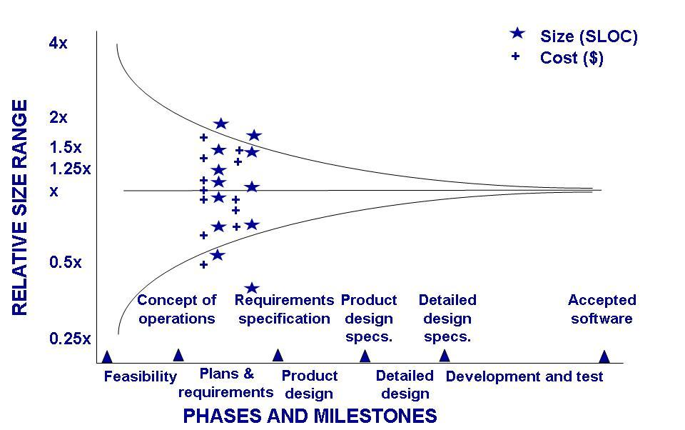
Effort Estimation Estimation Should be Done Repeatedly
Uncertainty early in the project can affect the accuracy of cost and size estimations
Notes:
The stars represent size estimates from actual projects, and the pluses are cost estimates. The funnel-shaped lines narrowing to the right represent Boehm’s sense of how our estimates get more accurate as we learn more about a project. Notice that when the specifics of the project are not yet known, the estimate can differ from the eventual actual cost by a factor of 4

Slide 5
3.3 Effort Estimation Sidebar 3.3 Causes of Inaccurate Estimates
Key causes
Frequent request for change by users
Overlooked tasks
User's lack of understanding of the requirements
Insufficient analysis when developing estimates
Lack of coordination of system development, technical services, operations, data administration, and other functions during development
Lack of an adequate method or guidelines for estimating

Slide 6
3.3 Effort Estimation Sidebar 3.3 Causes of Inaccurate Estimates (continued)
Key influences
Complexity of the proposed application system
Required integration with existing system
Complexity of the program in the system
Size of the system expressed as number of functions or programs
Capabilities of the project team members
Project team's experience with the application, the programming language, and hardware
Capabilities of the project team members
Database management system
Number of project team member
Extent of programming and documentation standards

Slide 7
Software Project Estimation
Options for estimation
Delay estimation until late in the project
Attractive, but not practical
Base estimates on similar projects that have already been completed
Unfortunately, past experience has not always been a good indicator of future results
Use relatively simple decomposition techniques to generate project cost and effort estimates
“Divide and conquer” approach
Use one or more empirical models for software cost and effort estimation
Can be used as a cross-check for the previous option and vice versa

Slide 8
Decomposition Techniques
Two different points of view for the decomposition approach
Decomposition of the problem
Decomposition of the process
But first, the project planner must
Understand the scope of the s/w to be built
Generate an estimate of its “size”

Slide 9
Estimating Size
The accuracy of a s/w project estimate is predicated on a number of things:
The degree to which the planner has properly estimated the size of the product to be built
The ability to translate the size estimate into human effort, calendar time, and dollars (required availability of past records)
The degree to which the project plan reflects the abilities of the s/w team
The stability of product requirements and the environment that supports the s/w engineering effort

Slide 10
Estimating Size
Sizing represents the project planner’s first major challenge
Size refers to a quantifiable outcome of the s/w project (e.g. LOC (Lines of Code) and/or FP(Function Points))

Slide 11
Problem-Based Estimation of Size
Example of baseline productivity metrics are LOC/pm or FP/pm
Making the use of single baseline productivity metric is discouraged
In general, LOC/pm or FP/pm averages should be computed by project domain. Projects should be grouped by team size, application area, complexity, and other relevant parameters
Local domain averages should be used

Slide 12
Problem-Based Estimation of Size
Statistical approach – three-point or expected-value estimate (Delphi’s Technique)
S = (s_{opt} + 4s_{m} + s_{pess})/6
S = expected-value for the estimation variable (size)
s_{opt} = optimistic value
s_{m} = most likely value
s_{pess} = pessimistic value

Slide 13
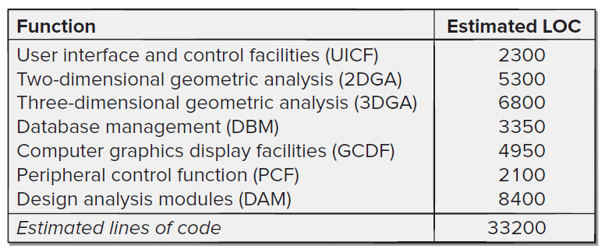
Problem-Based Estimation of Size
For example, the range of LOC estimates for the 3D geometric analysis function is optimistic, 4600 LOC; most likely, 6900 LOC; and pessimistic, 8600 LOC. Applying Equation, the expected value for the 3D geometric analysis function is 6800 LOC.
S = (s_{opt} + 4s_{m} + s_{pess})/6
S = (4600 + 4 * 6900 + 8600)/6
S = 6800 LOC

Slide 14
Problem-Based Estimation of Size
A review of historical data indicates that the organizational average productivity for systems of this type is 620 LOC/pm.
Based on a burdened labor rate of $8,000 per month, the cost per line of code is approximately $13. (8000/620 = 12.9)
Based on the LOC estimate and the historical productivity data, the total estimated project cost is $431,000. (33200*13 = 431600)
The estimated effort is 54 person-months. (33200/620=53.5)

Slide 15
Introduction to Function Points
Can be used effectively as a means for measuring the functionality delivered by a system
Using historical data, function points can be used to
Estimate the cost or effort required to design, code, and test the software
Predict the number of errors that will be encountered during testing
Forecast the number of components and/or the number of projected source code lines in the implemented system
Derived using an empirical relationship based on
Countable (direct) measures of the software’s information domain
Assessments of the software’s complexity
FP = count total * [0.65 + 0.01 * sum(F_{i})]

Slide 16
Introduction to Function Points
Information Domain Values
Number of external inputs
Number of external outputs
Number of external inquiries
Number of internal logical files
Number of external interface files
Value Adjustment Factors (VAF)
14 Factors

Slide 17
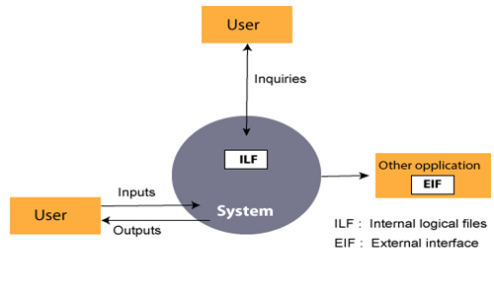
Information Domain Values

Slide 18
Information Domain Values
Number of external inputs
Each external input originates from a user or is transmitted from another application
They provide distinct application-oriented data or control information
They are often used to update internal logical files
They are not inquiries (those are counted under another category)
Number of external outputs
Each external output is derived within the application and provides information to the user
This refers to reports, screens, error messages, etc.
Individual data items within a report or screen are not counted separately

Slide 19
Information Domain Values
Number of external inquiries
An external inquiry is defined as an online input that results in the generation of some immediate software response
The response is in the form of an online output
Number of internal logical files
Each internal logical file is a logical grouping of data that resides within the application’s boundary and is maintained via external inputs
Number of external interface files
Each external interface file is a logical grouping of data that resides external to the application but provides data that may be of use to the application

Slide 20
Value Adjustment Factors
Does the system require reliable backup and recovery?
Are specialized data communications required to transfer information to or from the application?
Are there distributed processing functions?
Is performance critical?
Will the system run in an existing, heavily utilized operational environment?
Does the system require on-line data entry?
Does the on-line data entry require the input transaction to be built over multiple screens or operations?

Slide 21
Value Adjustment Factors
Are the internal logical files updated on-line?
Are the inputs, outputs, files, or inquiries complex?
Is the internal processing complex?
Is the code designed to be reusable?
Are conversion and installation included in the design?
Is the system designed for multiple installations in different organizations?
Is the application designed to facilitate change and for ease of use by the user?

Slide 22
Function Point Computation
Identify/collect the information domain values
Complete the table shown below to get the count total
Associate a weighting factor (i.e., complexity value) with each count based on criteria established by the software development organization
Evaluate and sum up the adjustment factors (see example in the next few slides)
“F_{i}” refers to 14 value adjustment factors, with each ranging in value from 0 (not important) to 5 (absolutely essential)
Compute the number of function points (FP) FP = count total * [0.65 + 0.01 * sum(F_{i})]
Information Weighting Factor
Domain Value Count Simple Average Complex
External Inputs _____ x 3 4 6 = _____
External Outputs _____ x 4 5 7 = _____
External Inquiries _____ x 3 4 6 = _____
Internal Logical Files _____ x 7 10 15 = _____
External Interface Files _____ x 5 7 10 = _____ Count total ________

Slide 23
Function Point Example
Information Weighting Factor
Domain Value Count Simple Average Complex
External Inputs 3 x 3 4 6 = 9
External Outputs 2 x 4 5 7 = 8
External Inquiries 2 x 3 4 6 = 6
Internal Logical Files 1 x 7 10 15 = 7
External Interface Files 4 x 5 7 10 = 20 Count total 50
FP = count total * [0.65 + 0.01 * sum(F_{i})]
FP = 50 * [0.65 + (0.01 * 46)]
FP = 55.5 (rounded up to 56)

Slide 24
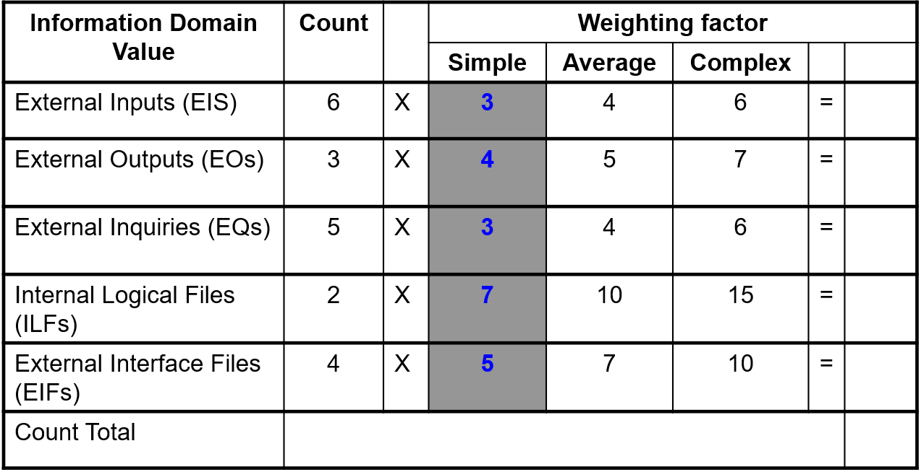
An Example of FP-Based Estimation

Slide 25
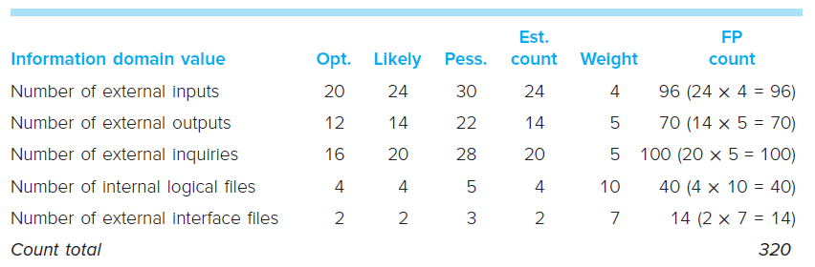
An Example of FP-Based Estimation
For the purpose of this estimate, the complexity weighting factor is assumed to be average

Slide 26
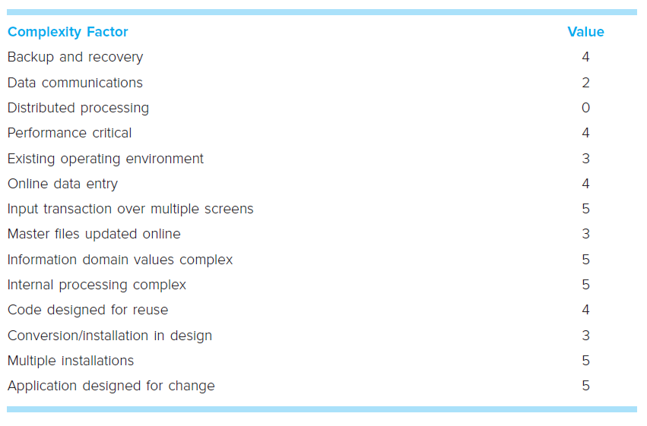
An Example of FP-Based Estimation
52
Value Adjustment Factors

Slide 27
An Example of FP-Based Estimation
Now,
FP_{estimated} = count_total × [0.65 + 0.01 × Σ (F_{i})]
F_{i} (i = 1 to 14 are value adjustment factors)
So,
FP_{estimated} = 320 × [0.65 + 0.01 × 52] = 375 (approx.)
Let,
Average Productivity = 6.5 FP/pm
Labor rate = $8,000 per month
So,
Cost per FP = Labor Rate/Average Productivity = $1,230 (approx.)
Total estimated project cost = FP_{estimated} * Cost per FP = $461,000 (approx.)
Estimated effort = FP_{estimated} / Average Productivity = 58 person-months (approx)

Slide 28
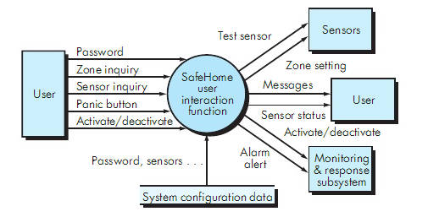
An Example
password, panic button, activate/deactivate
zone inquiry, sensor inquiry
system configuration file
messages, sensor status
test sensor, zone setting, alarm alert, a/d
Let ΣF_{i} = 46
Size in FP?
Effort?
Cost?

Slide 29
Estimating Size
A hierarchy of estimation models
Address the following areas
Application composition model
Early design stage model
Post-architecture stage model
Three different sizing options are available
Application points
Function points
Lines of source code

Slide 30
Effort Estimation COCOMO (Constructive Cost Model)
Introduced by Boehm
COCOMO I
effort as a function of size
COCOMO II
updated version
effort as a function of size
Includes cost factors as a multiplier
include models of reuse
requires sizing information like all other models

Slide 31
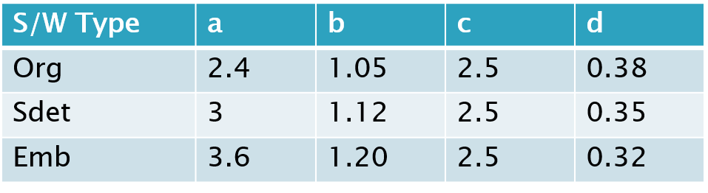
Effort Estimation COCOMO I
Effort (E) = a (KLOC)^{b} person_months
Development Time (D) = c x E ^{d} months
Organic: small teams, rigid requirements
Semi detached: medium teams, less rigid requirements
Embedded: combination of O and S (h/w, s/w,…)

Slide 32
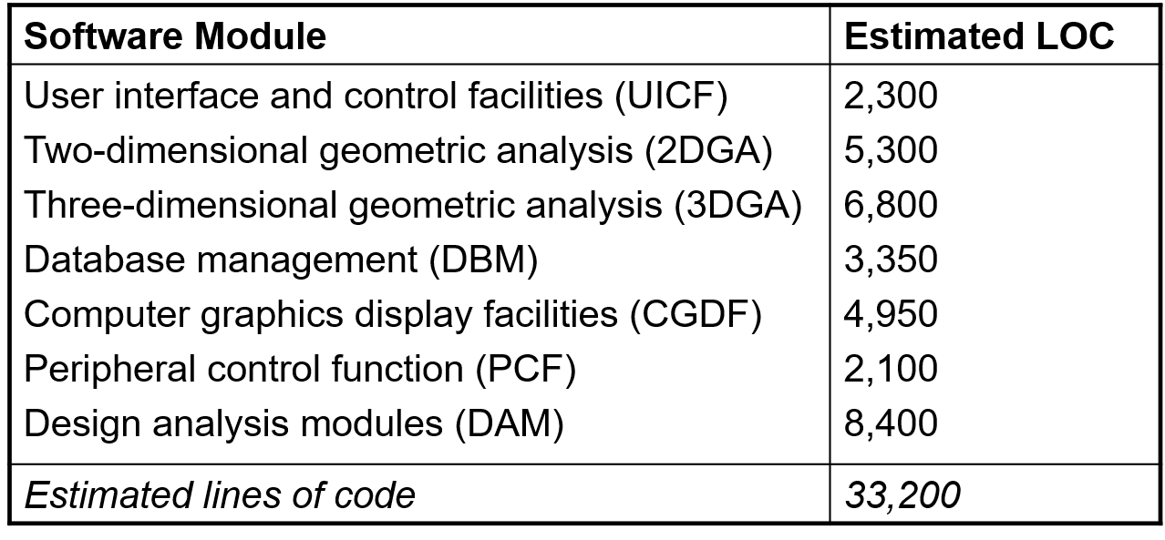
An Example
E?
D?

Slide 33
An Example
KLOC = 33200/1000 = 33.2
E = 2.4*(33.2)^1.05 = 94.9 = (approx. 95 p-m)
D = 2.5*(94.9)^0.38 = 14.10 = (approx. 14 months)

Slide 34
An Example
KLOC = 33200/1000 = 33.2
E = 2.4*(33.2)^1.05 = 94.9 = (approx. 95 p-m)
D = 2.5*(94.9)^0.38 = 14.10 = (approx. 14 months)
Person Estimation = N = E/D = 95/14 = (approx. 7 person)
Productivity = P = KLOC/E = 33.2/95 = 0.34 KLOC/PM

Slide 35
Effort Estimation COCOMO II: Stages of Development
Application composition
prototyping to resolve high-risk user interface issues
size estimates in application/object points
Early design
to explore alternative architectures and concepts
size estimates in function points
Post architecture
development has begun
size estimates in lines of code

Slide 36
Estimating Size
Application points are computed using counts of the number of
Screens (at the user interface)
Reports
Components likely to be required to build the application

Slide 37
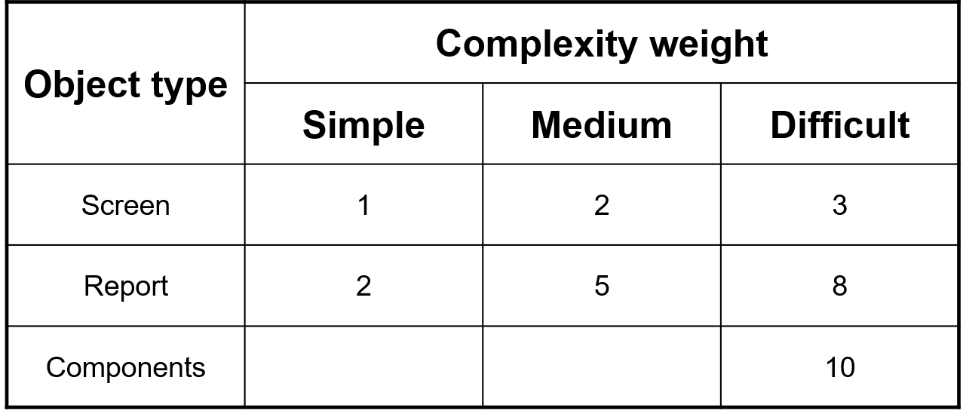
Estimating Size
Complexity weights for object types

Slide 38
Estimating Size
Determine Object Points: Add all weighted object instances to get object point count

Slide 39

Estimating Size
Determine object points based on reuse of code
New Object Points (NOP) = $\frac{Object points ∗ \left(100 − \% resuse\right)}{100}$
NOP differ from the object point count because there may be reuse

Slide 40
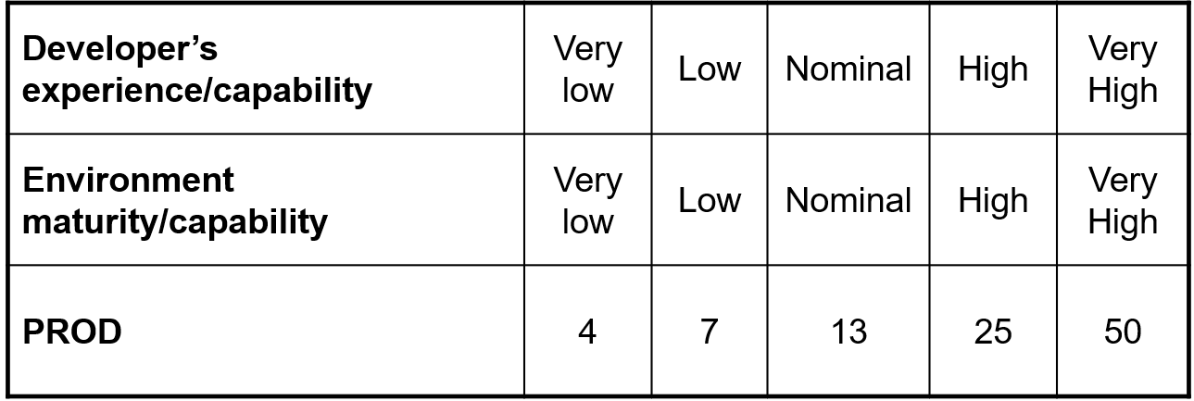
Estimating Size
Productivity rate for object points

Slide 41

Estimating Size
Effort in PM = $\frac{NOP}{PROD}$

Slide 42
Cocomo-II Example
Use Cocomo-II model to estimate effort required to build an Order Taking system for restaurant that produces 15 screens, 6 reports and will require 70% new software components. Assume average complexity and average developer/environment maturity.
Object | Count | Complexity | Weight Factor | Total Objects
Screen | 15 | Medium | 2 | 30
Report | 6 | Medium | 5 | 30
Components | 0 | NA | NA | 0
Total Object Points: |  |  |  | 60

Slide 43
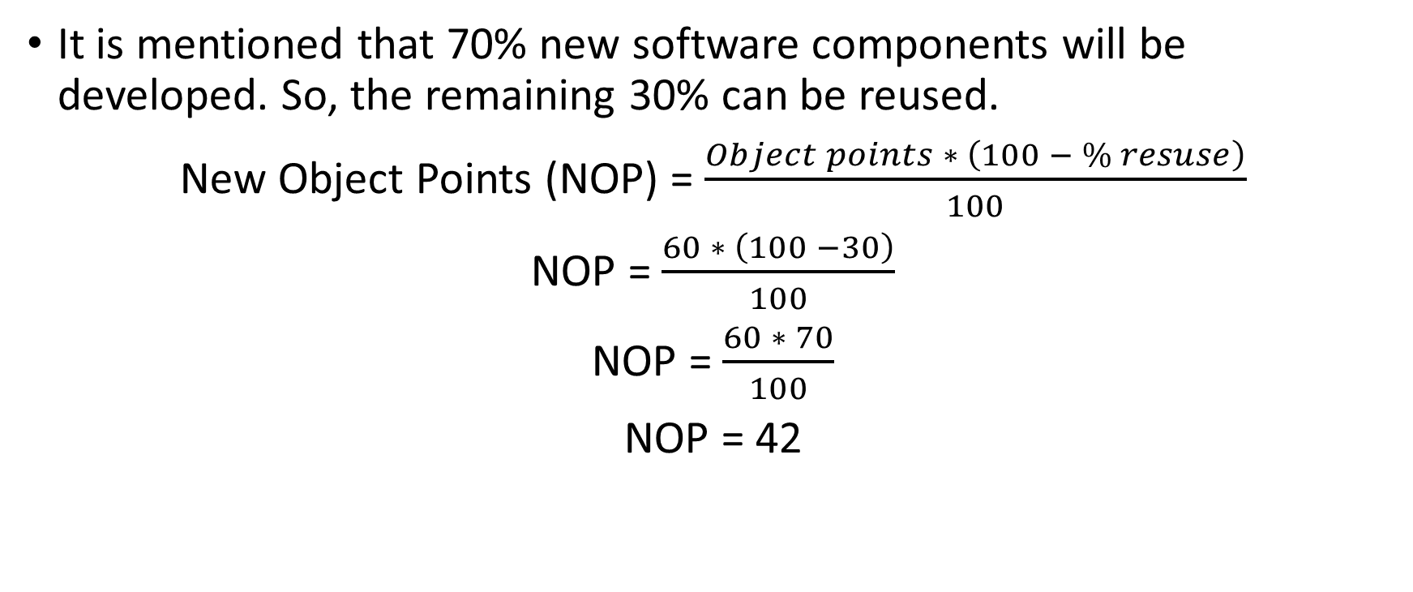
Cocomo-II Example
It is mentioned that 70% new software components will be developed. So, the remaining 30% can be reused.
New Object Points (NOP) = $\frac{Object points ∗ \left(100 − \% resuse\right)}{100}$
NOP = $\frac{60 ∗ \left(100 −30\right)}{100}$
NOP = $\frac{60 ∗ 70}{100}$
NOP = 42

Slide 44
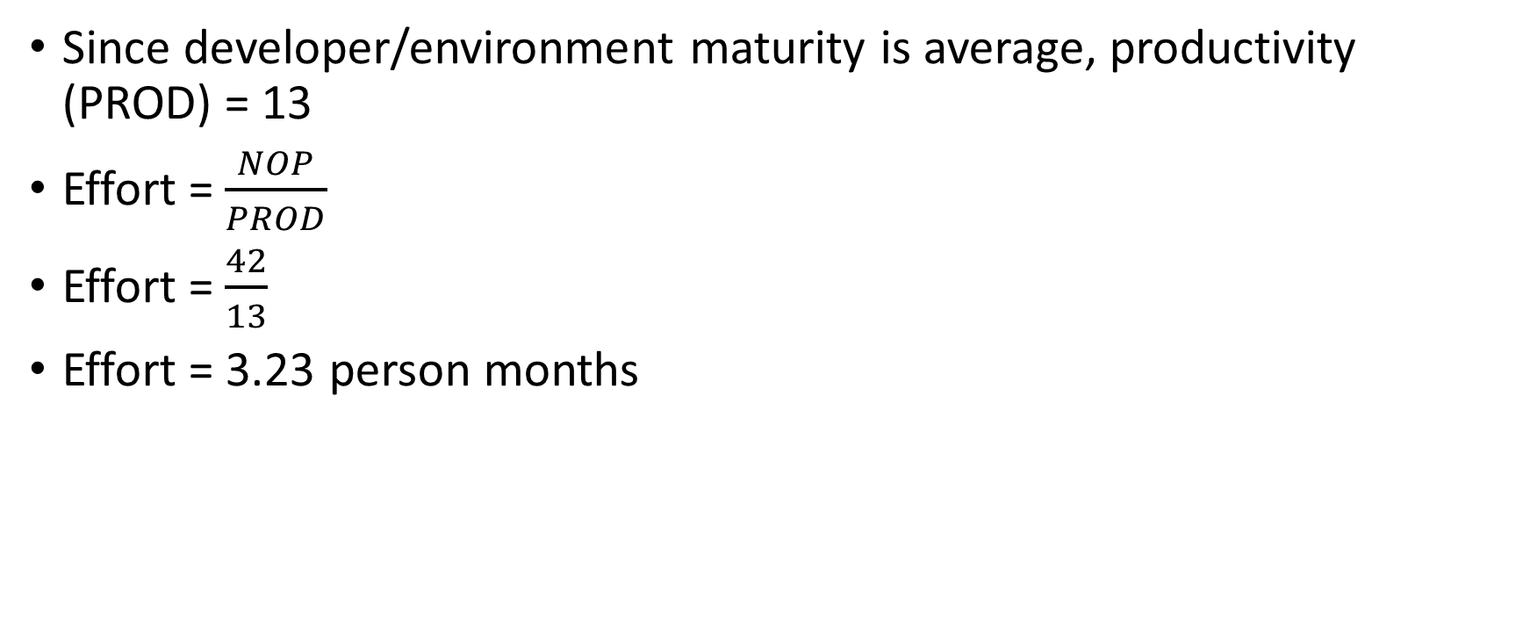
Cocomo-II Example
Since developer/environment maturity is average, productivity (PROD) = 13
Effort = $\frac{NOP}{PROD}$
Effort = $\frac{42}{13}$
Effort = 3.23 person months

Slide 45
References
Shari PFleeger, Joanne Atlee, Software Engineering: Theory and Practice, 4th Edition
Roger S. Pressman, Software Engineering A Practitioner’s Approach, 9th Edition. McGrawHill

